Slide 1
Year 7 –10
Homework Login Support
Email: Homework@hartshillacademy.org.uk

Slide 2
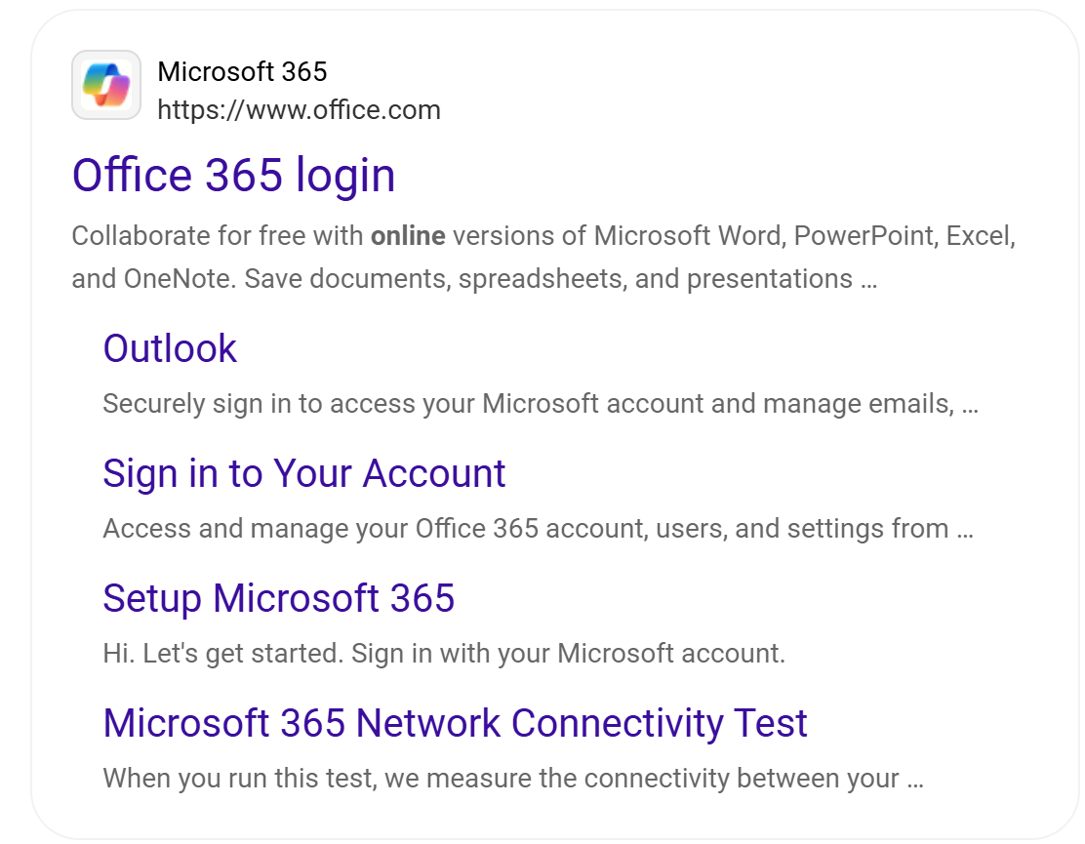
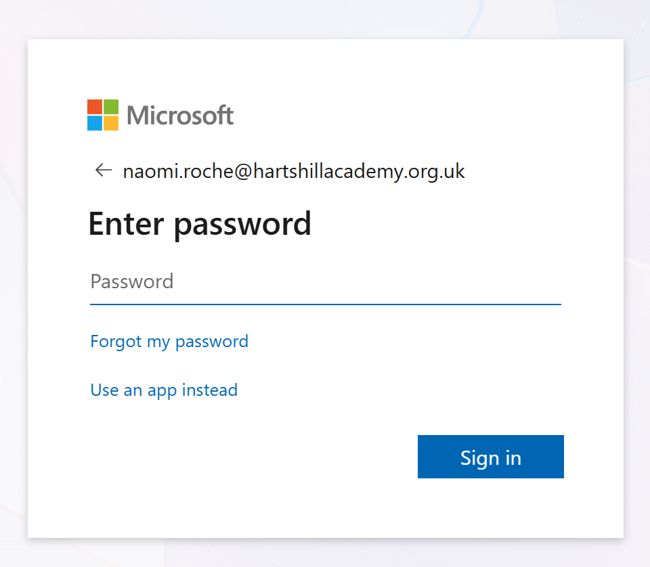
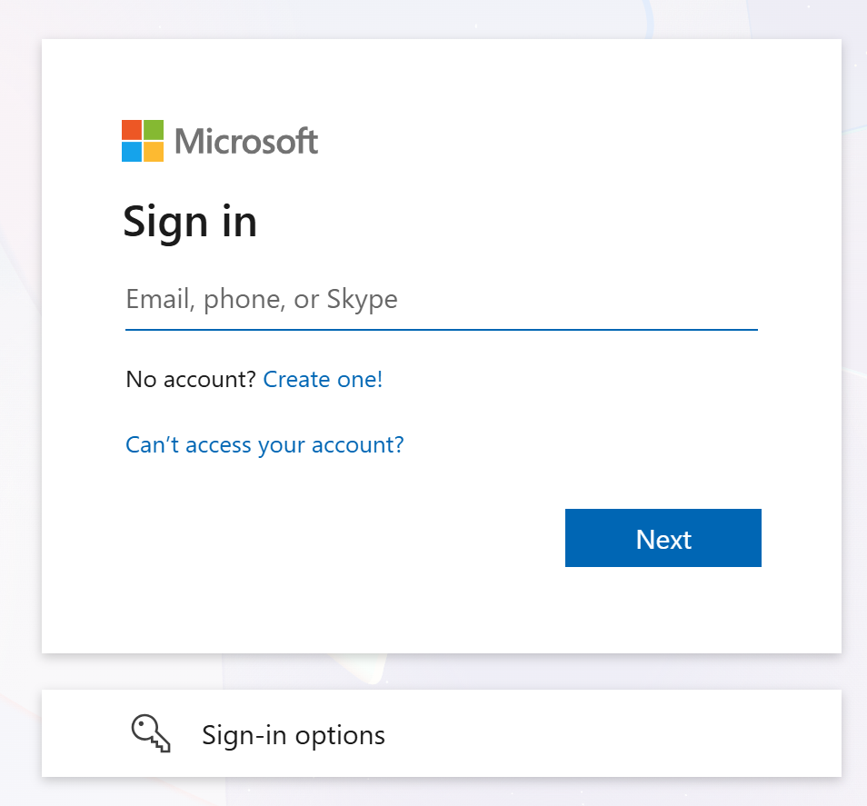
Microsoft 365 First Login
Step 3:
Enter your Password
Password is your Date of Birth
Format:
2 numbers for the date, 3 letters in Capital first letter and 4numbers for the year.
Example:
01Jun2023
23Dec2025
31Jan2021
Step 1:
Google ‘Office 365’
Step 2:
Enter your school
email address
Format:
The year you started
First 2 letters of first name
Dot
Surname
@
stu.hartshillacademy.org.uk
Example:
Hs21ma.brown@stu.hartshillacademy.org.uk
Step 4:
You must remember it.

Slide 3
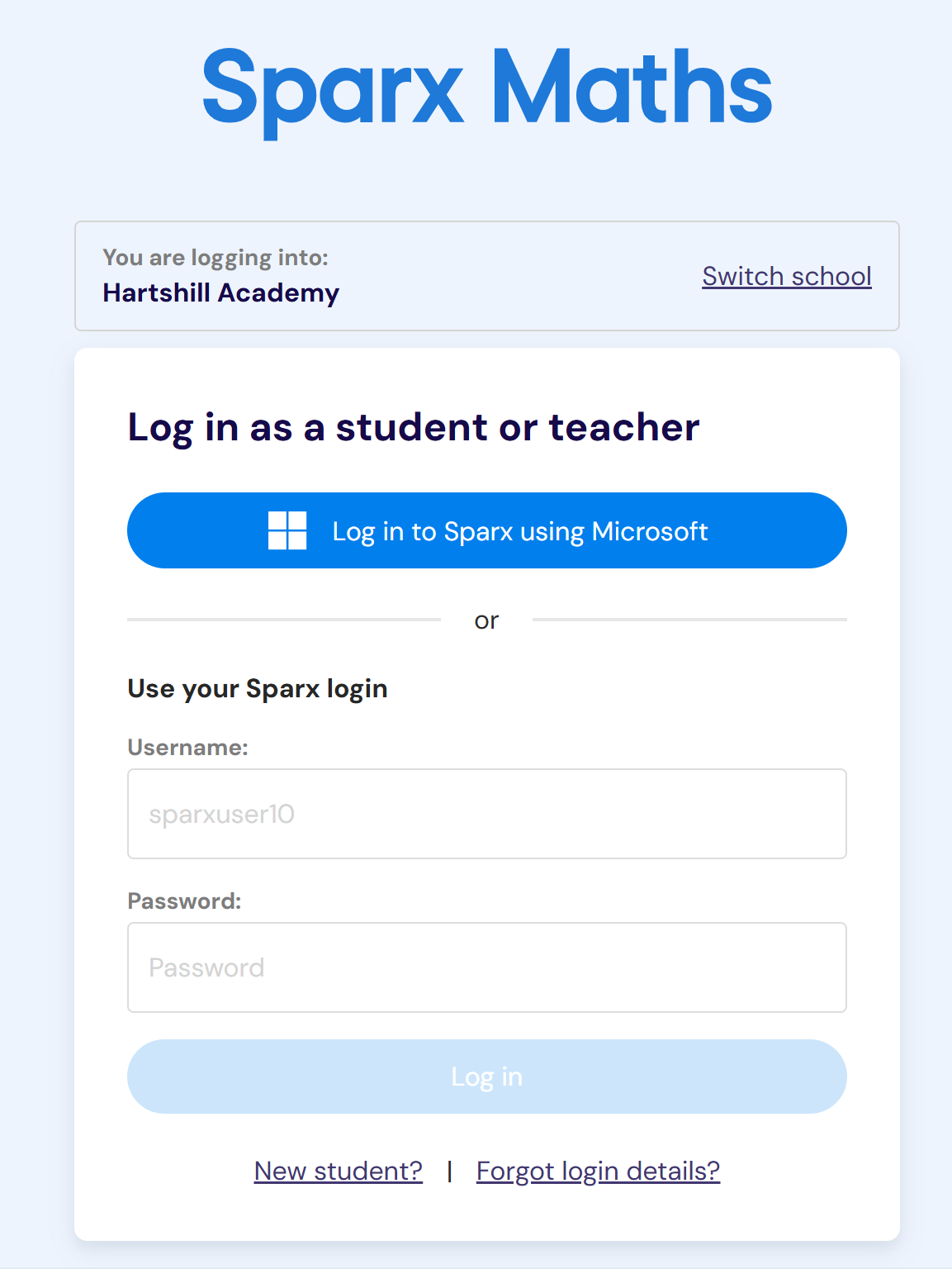
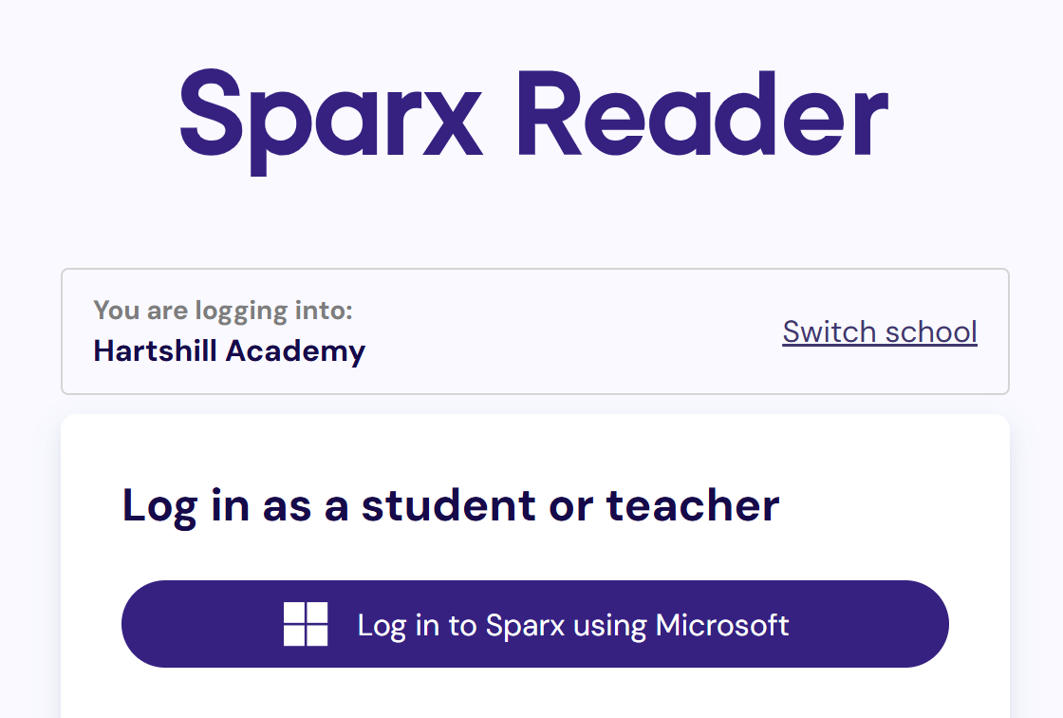
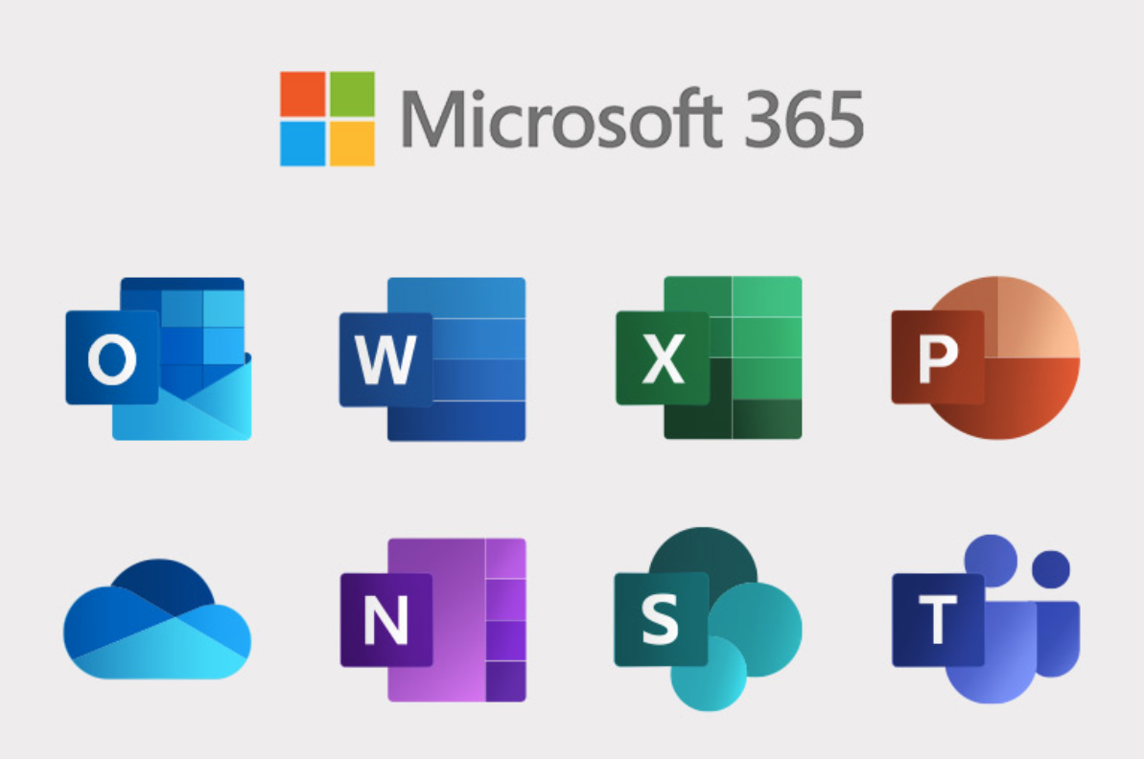

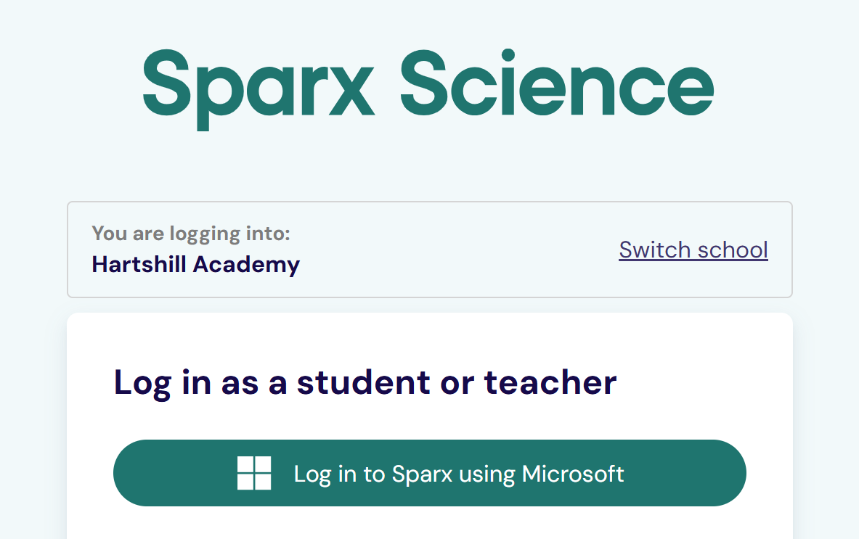

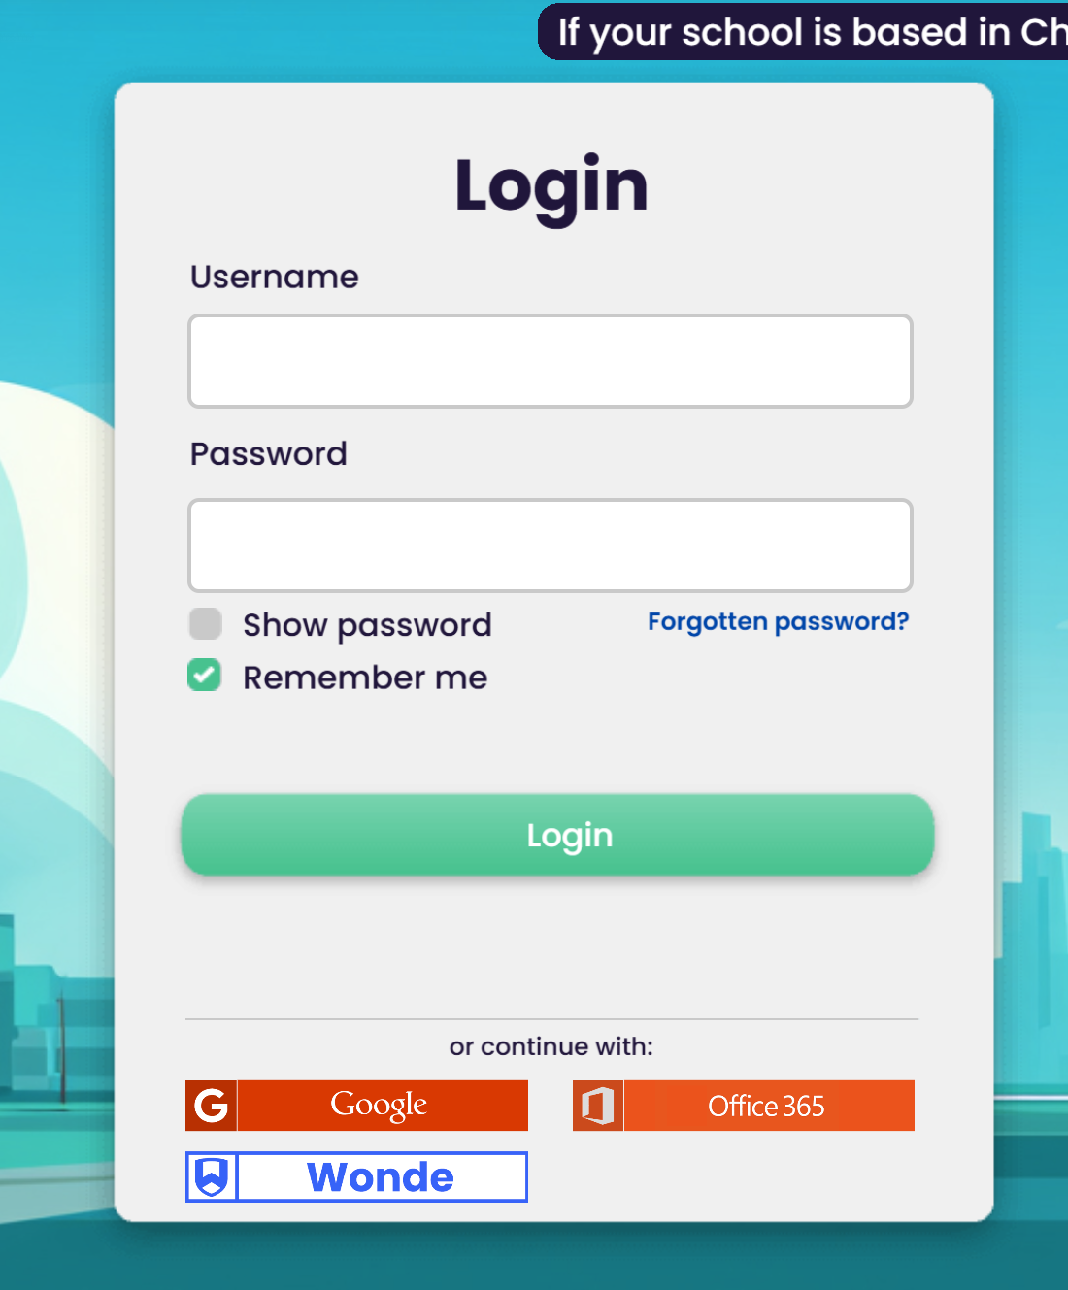
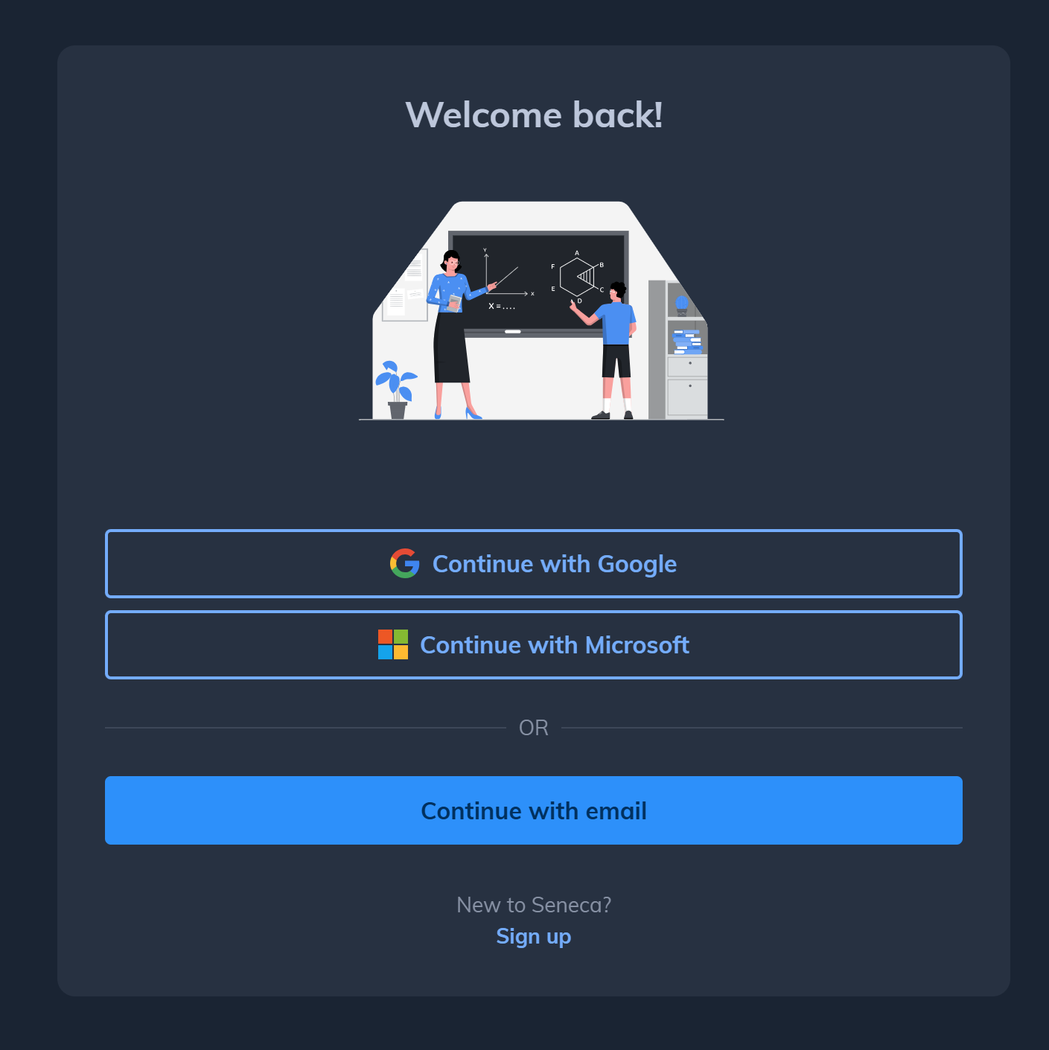

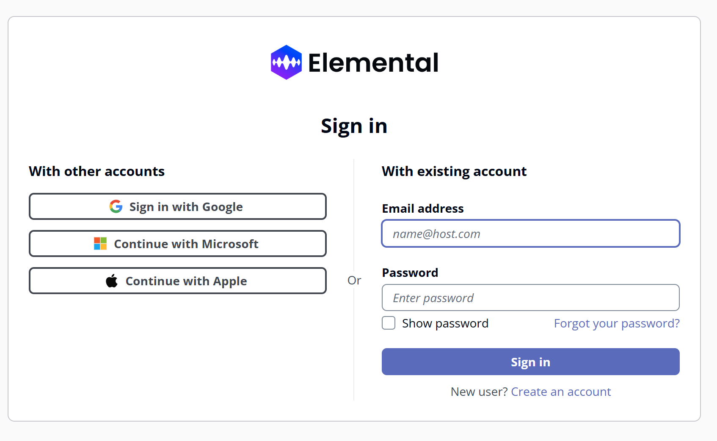
Homework platforms
You can now sign in to all platforms using your Microsoft login.

Slide 4
Homework Platform Links
Sparx Maths Login
Sparx Science Login
Sparx Reader Login
Seneca Login
Elemental Music Login
Languagenut Login

